Slide 1













WELCOME TO DFW - RIMS
2024
FALL CONFERENCE & SPA EVENT
Texas Risk Roundup
FALL CONFERENCE
SEPTEMBER 19, 2024
IRVING CONVENTION CENTER
SPA EVENT
SEPTEMBER 20, 2024
RELACHE SPA AT GAYLORD TEXAN
TITLE SPONSOR

Slide 2


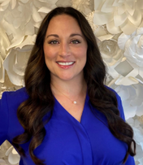
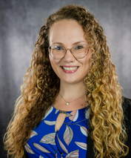
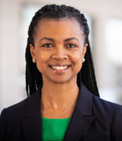
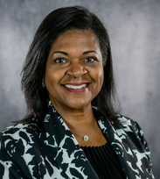
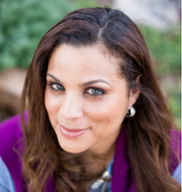
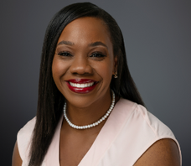


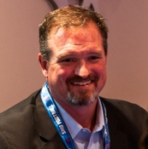
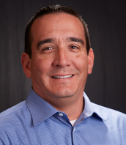
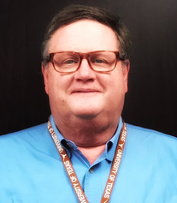
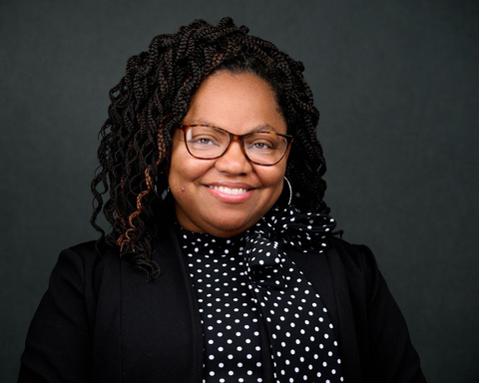
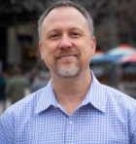

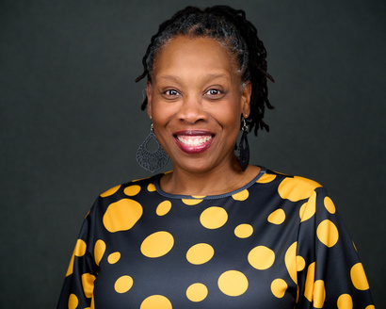
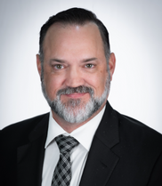
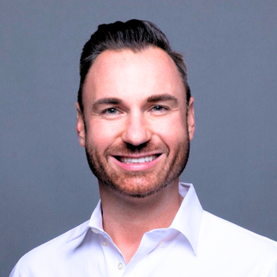
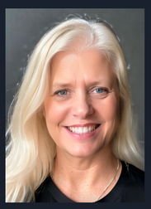
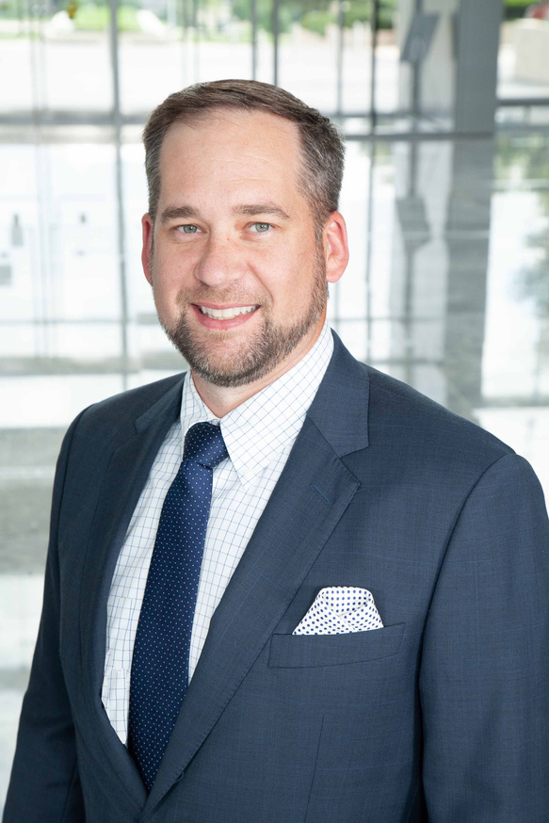
WELCOME
to the 2024
DFW RIMS Fall Conference
2024 Executive Officers
Emily Casso
Marissa Holland
Catrina Gilbert
Pamela Bradshaw
Tiara Wallace
LaToya Lee
President
Vice President
Treasurer
Secretary
Assistant Secretary
Past President
Globe Life
Hillwood, a Perot Company
DFW International Airport
Varsity Brands, LLC
Invesco Real Estate
Raising Cane’s
Restaurants, LLC
Jason Hunt
Bill Plisga
Mark Barta
Veronica Brooks
Jason Shepard
Education
Chair
Director
External Affairs
Chair
Communications
Chair
Director
Enterprise Holdings
RATP Dev
City of McKinney
Topgolf
Sherrill Wilson
Jason Turk
Jason Znoy
Sara Coleman
Ty Sheaks
Community Impact
Chair
Membership
Chair
Social
Chair
Advisor
Advisor
MV Transit
Bondy Law Group
Sedgwick
SIGMA 7 / RWH Myers
McCathern, Shokouhi,
Evans PLLC

Slide 3



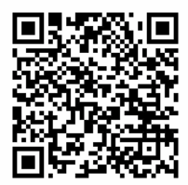


AGENDA
DAY 1
Thursday, September 19, 2024
Time
8:15AM - 9:30AM
8:30 AM -8:40AM
8:45AM - 9:15 AM
8:45AM - 9:15 AM
8:45AM - 9:15 AM
9:30AM - 9:50AM
9:50AM - 10:30AM
10:45AM - 11:00AM
11:00AM - 12:00PM
11:00AM - 12:00PM
11:00AM - 12:00PM
12:00PM - 1:00PM
12:00PM - 1:00PM
1:15PM - 2:15PM
1:15PM - 2:15PM
1:15PM - 2:15PM
2:15PM - 2:30PM
2:30PM - 3:30PM
3:30PM - 5:00PM
Room
Exhibitor Midway
Exhibitor Midway
Western Heritage
Fair Park Suite
State Fair Pavilion
Risk Roundup Room
Risk Roundup Room
Exhibitor Midway
Western Heritage
Fair Park Suite
State Fair Pavilion
Big Tex Hall
Risk Roundup Room
Western Heritage
Fair Park Suite
State Fair Pavilion
Exhibitor Midway
Risk Roundup
Exhibitor Midway
Description
Registration
Coffee with Board on the Midway!
Addressing Emerging Insurance Challenges in Risk Management
Welcome to the Midway: Preparing for Chaos on the Witness Stand
Trailblazing Your Career
Opening Remarks
Keynote Speaker: State Office of Risk Management
Snack Break!
Juggling Risks: Don’t Clown Around with Effective Risk Management in Texas
Big Tex + AI = Big Risk; Is Your Insurance Ready for The Ride?
How to Ride the Risk and Resilience Roller Coaster Without Losing Your Lunch
Lunch
Risk Manager* Exclusive Forum, Lunch
Fair Play – Tips on Exposing and Defeating Fraudulent Operations
Disaster on the Midway: Shifting Mindset
Wrangling in the Big Ones: Mastering Common, Complex, and Catastrophic
Work Comp Injury Claims in the Lone Star State
Snack Break/ Networking - Exhibition Hall Time
Closing Session: Securing the Homeland: Homeland Security Investigations
Midway games, Happy Hour, and raffle (must be present to win!)
DAY 2
Thursday, September 20, 2024
DAY 2
    DFW RIMS has reserved the entire spa at the Gaylord Texan from 9:00am - 4:00pm. We look forward to relaxing and unwinding together!
    This event is SOLD OUT!

Slide 4

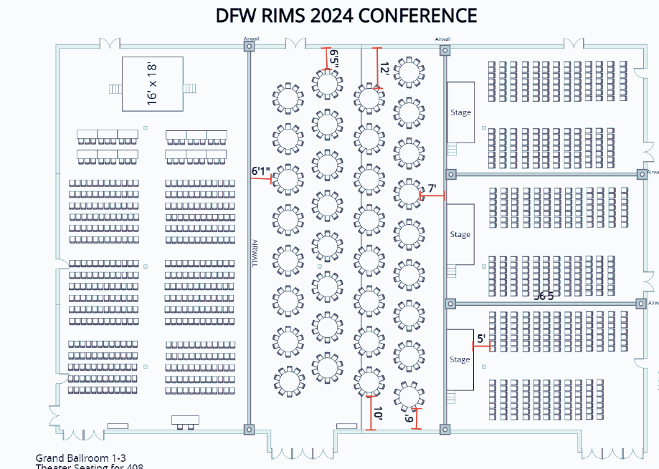




CONFERENCE ROOM MAP
Western Heritage
Fair Park Suite
Booklet:
State Fair Pavilion
Risk Roundup
Big TEX Hall

Slide 5

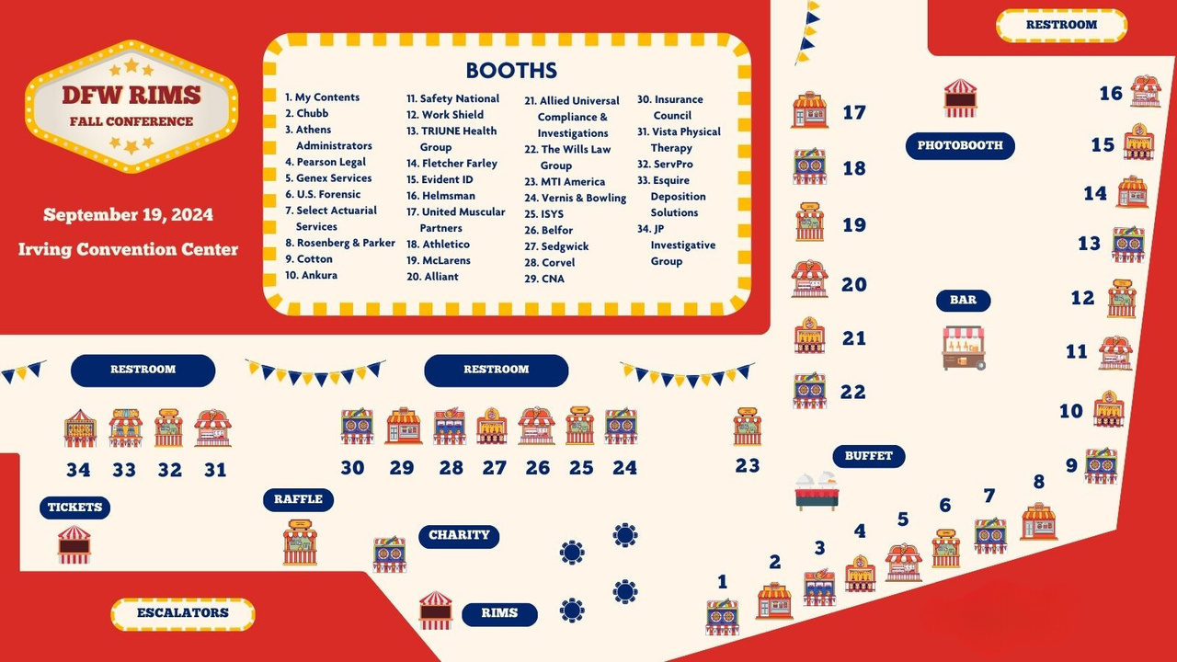



EXHIBITOR MAP
RESTROOM
Booklet:

Slide 6




THANK YOU!
FALL CONFERENCE
PLANNING COMMITTEE
Thank you to all other volunteers who helped make this event happen!
We could not do it without you.
Conference Chair: Marissa Holland, CPCU, RIMS-CRMP
General Advisor: Sara Coleman
Communications: Veronica Brooks, Steve Grindinger, and Andy Rausch
Marketing/Sponsorships: Jason Znoy, Jacque Jagger, Michelle Cruff, and Tammy Jowers
Accounting: Catrina Gilbert and Sandra Fontenot
Logistics: Megan Fuchs, Michelle Cruff, Karen Mayfield, Sharon Coury, and Faith Likekele
Vendor Contact: Andy Rausch, Nick Gannon, and Megan Fuchs
Décor: Sharon Coury
Spa: Sara Coleman, Tiara Wallace, Kären Mayfield, and Michelle Cruff

Slide 7




















THANK YOU!
Sponsors
Title Sponsor
Gold Sponsors
Silver Sponsors

Slide 8


















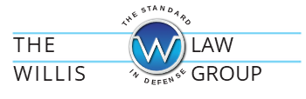







THANK YOU SPONSORS!
RIMSCast LIVE!
Parking Sponsor
Lunch Sponsors
Snack Sponsors
Breakfast Sponsors
Happy Hour Sponsors

Slide 9
















THANK YOU SPONSORS!
Midway Decor Sponsors
Name Tag Sponsor
Program Booklet Sponsor
Raffle Sponsors
Shuttle Sponsor
Photo Booth Sponsor
General Exhibitors
Pearson Legal
Ankura
Genex Services
Fletcher Farley
Select Actuarial Services
Allied Universal Compliance and Investigations

Slide 10











DFW RIMS SPA EVENT
Relâche Spa
The Gaylord Texan
September 20, 2024
9:00AM - 4:00PM
Unwind & Connect
TITLE SPONSOR
Beverage Sponsor
Food & Snack Sponsor
Raffle Sponsor

Slide 11


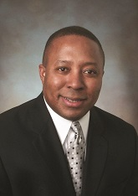
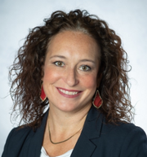
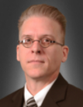


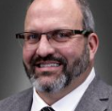

Panelist:
KEYNOTE
Rodeo Masters: A Look at the Texas State Office of Risk Management
Moderator:
Gerald Ladner, Sr.,
Board Chairman of the Board of Directors
Penni Chambers,
Vice President, Risk Management
Hillwood
Stephen Vollbrecht,
Executive Director,
State Risk Manager for Texas
James Cox,
Division Chief of Strategic Programs

Slide 12
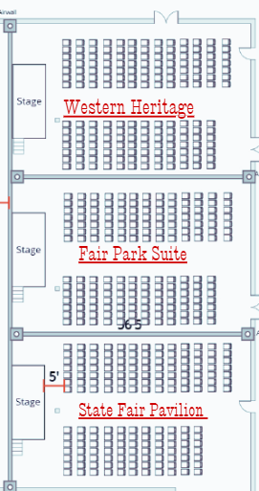

Break and A.M Session!
10:45 AM – 11:00 AM Exhibitor Midway
Networking Break, Snacks
11:00 AM – 12:00 PM
Western Heritage
Title: Juggling Risks: Don’t Clown Around with Effective Risk Management in Texas
Presenter: Roma Rishi, Sales Executive, Origami Risk and Scott McNea, VP Alliant Insurance Service, Inc
Fair Park Suite
Title: Big Tex + AI = Big Risk; Is Your Insurance Ready for The Ride?
Presenter: Anthony Rapa, Director, SR Client Advocate WTW and Michael S. Levine Partner Hunton Andrews Kurth, LLP
State Fair Pavilion
Title: How to Ride the Risk and Resilience Roller Coaster Without Losing Your Lunch
Presenters: Taylor Mapula, Director Enterprise Risk Management- Globe Life Inc., Lisanne Sison, Managing Director, ERM Practice - Arthur J Gallagher Risk Management Services LLC, Dianne Stephens, Senior Manager, Enterprise Resilience – Globe Life Inc.

Slide 13




CLOSING
Securing the Homeland: Homeland Security Investigations with specific focus into Financial/cryptocurrency investigations
Special Agent Christopher Rodriguez presents an overview of Homeland Security
Investigations and its capabilities with a specific focus on
Financial/cryptocurrency investigations.

Slide 14



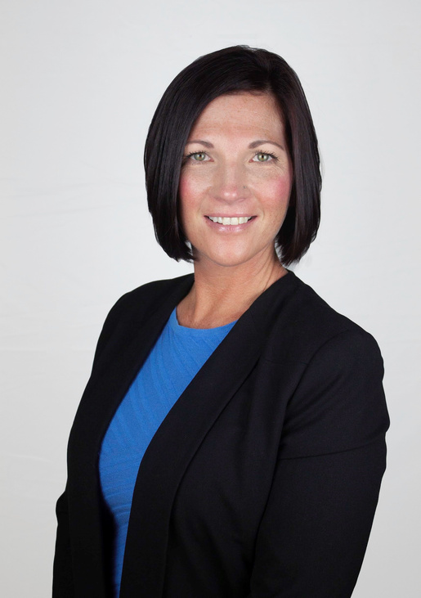
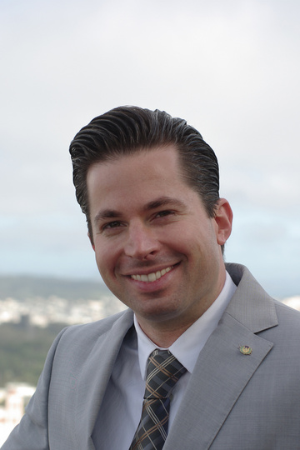
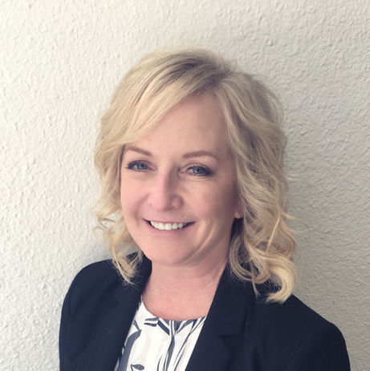
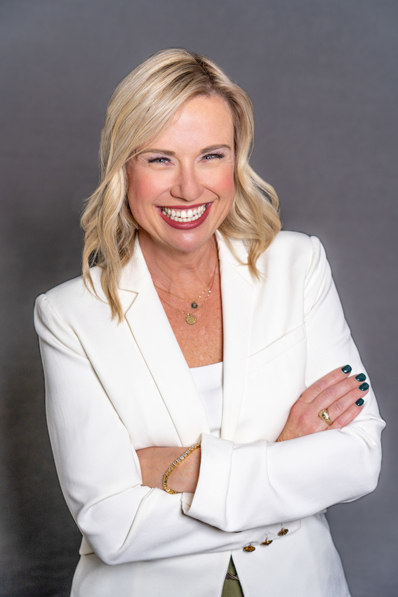
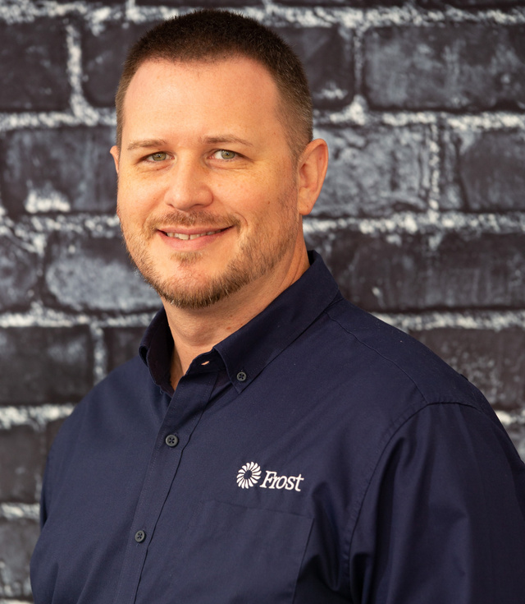
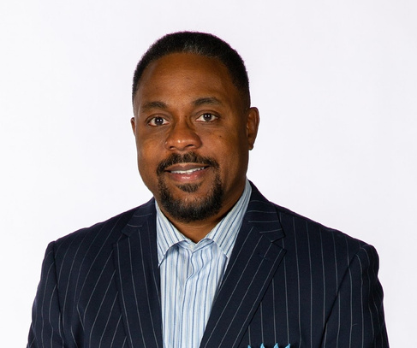


2025 Board Candidates
Megan Fuchs
Brightline Insurance
Services
Rory Haynie
LegalNet, Inc.
Jacque Jagger
Belfor Property
Restoration
Allison Kelly
Sedgwick
Anthony Moore
Frost Insurance
Agency
Marshall Taylor II
Work Shield

Slide 15



COMMUNITY
IMPACT
https://tinyurl.com/TexasRiskRoundupCharity
Visit the Make-A-Wish table!
Located next to the elevator.

Slide 16


COMMUNITY
IMPACT
Drop Off Your Conference Swag!
Drop off is located next to the elevator. Drop off is upon exit.

Slide 17





GRANT
School: UNT $5,000
Scholarship Total
Awarded: $42,500
Kyndra Raymond
School: UNT
Major: RMI
Graduates: 12/31/2025
Aminat Alaka
School: UNT
Major: RMI & BCIS
Graduates: 12/31/2026
Harizah Kabiruddin
School: UNT
Major: RMI
Graduates: 5/9/2025
SCHOLARSHIP
& GRANT
RECIPIENTS
Brock Polydoroff
School: UNT
Major: RMI
Graduates: 5/9/2025
Catherine Koja
School: UNT
Major: RMI
Graduates: 12/15/2024
Dung Nguyen
School: UT Dallas
Major: Finance
Graduates: 5/22/2025
Krysten Hicks
School: UNT
Major: RMI
Graduates: 5/1/2025
CONGRATULATIONS!
Karine Chalhoub
School: UNT
Major: Finance
Graduates:12/13/2024
Samuel Zimel
School: UNT
Major: Mathematics
Graduates: 12/9/2025

Slide 18



FOUNDING
1979
RIMS Atlanta Chapter establishes the Spencer Educational Foundation after the passing of Robert S. Spencer (1929-1979).
CORE PROGRAMMING
    Scholarship Program
    General Grant Program
    Internship Grant Program
    RMOC Grant Program
    Course Development Grant Program
    Student Risk Management Challenge
SCHOLARSHIPS
$10.5 MILLION+
Spencer awards scholarships to undergraduate, graduate, and Ph.D. students, along with working RMI professionals pursuing their master’s degrees.
OTHER RESOURCES
    Mentorship Program
    Student Webinar Series
    Student Speaking Engagements
    Collaboration With Other Organizations
    Promote Free RMI Industry Resources
GRANTS
Spencer’s various grant programs support student-centered initiatives at universities and industry organizations that fall into the following two critical branches:
A) Provide experiential learning opportunities for RMI students, and
B) Attract new talent to the industry.
$9 MILLION+
100,000+
STUDENTS IMPACTED
Students across USA and Canada!
SPENCERED.ORG

Slide 19






